Slide 1

Embedded Real-Time Control
A.A. 2022/2023
Bettin Paolo - 2089152
Vitetta Emanuele - 2086147
Merolli Martina – 2072012
Guglielmin Giorgia – 2088623
Bonaventura Luca - 2090005

Slide 2
Laboratory 1 – Basics

Slide 3
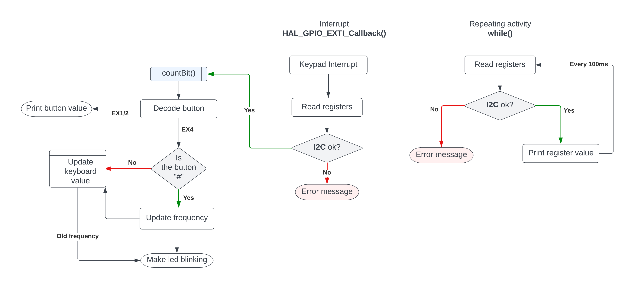
Flowchart

Slide 4
Conclusions

Slide 5
Laboratory 2 – Camera stabilizer

Slide 6
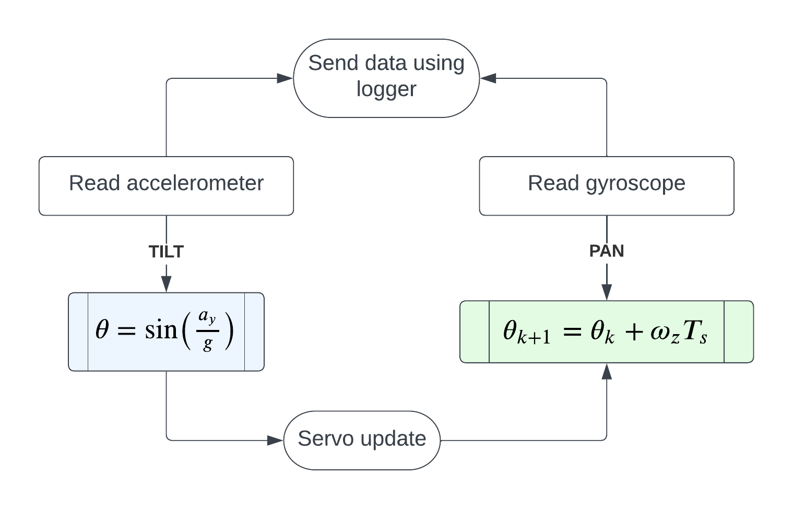
Flowchart

Slide 7
Conclusions

Slide 8
Laboratory 3 – Motor control

Slide 9
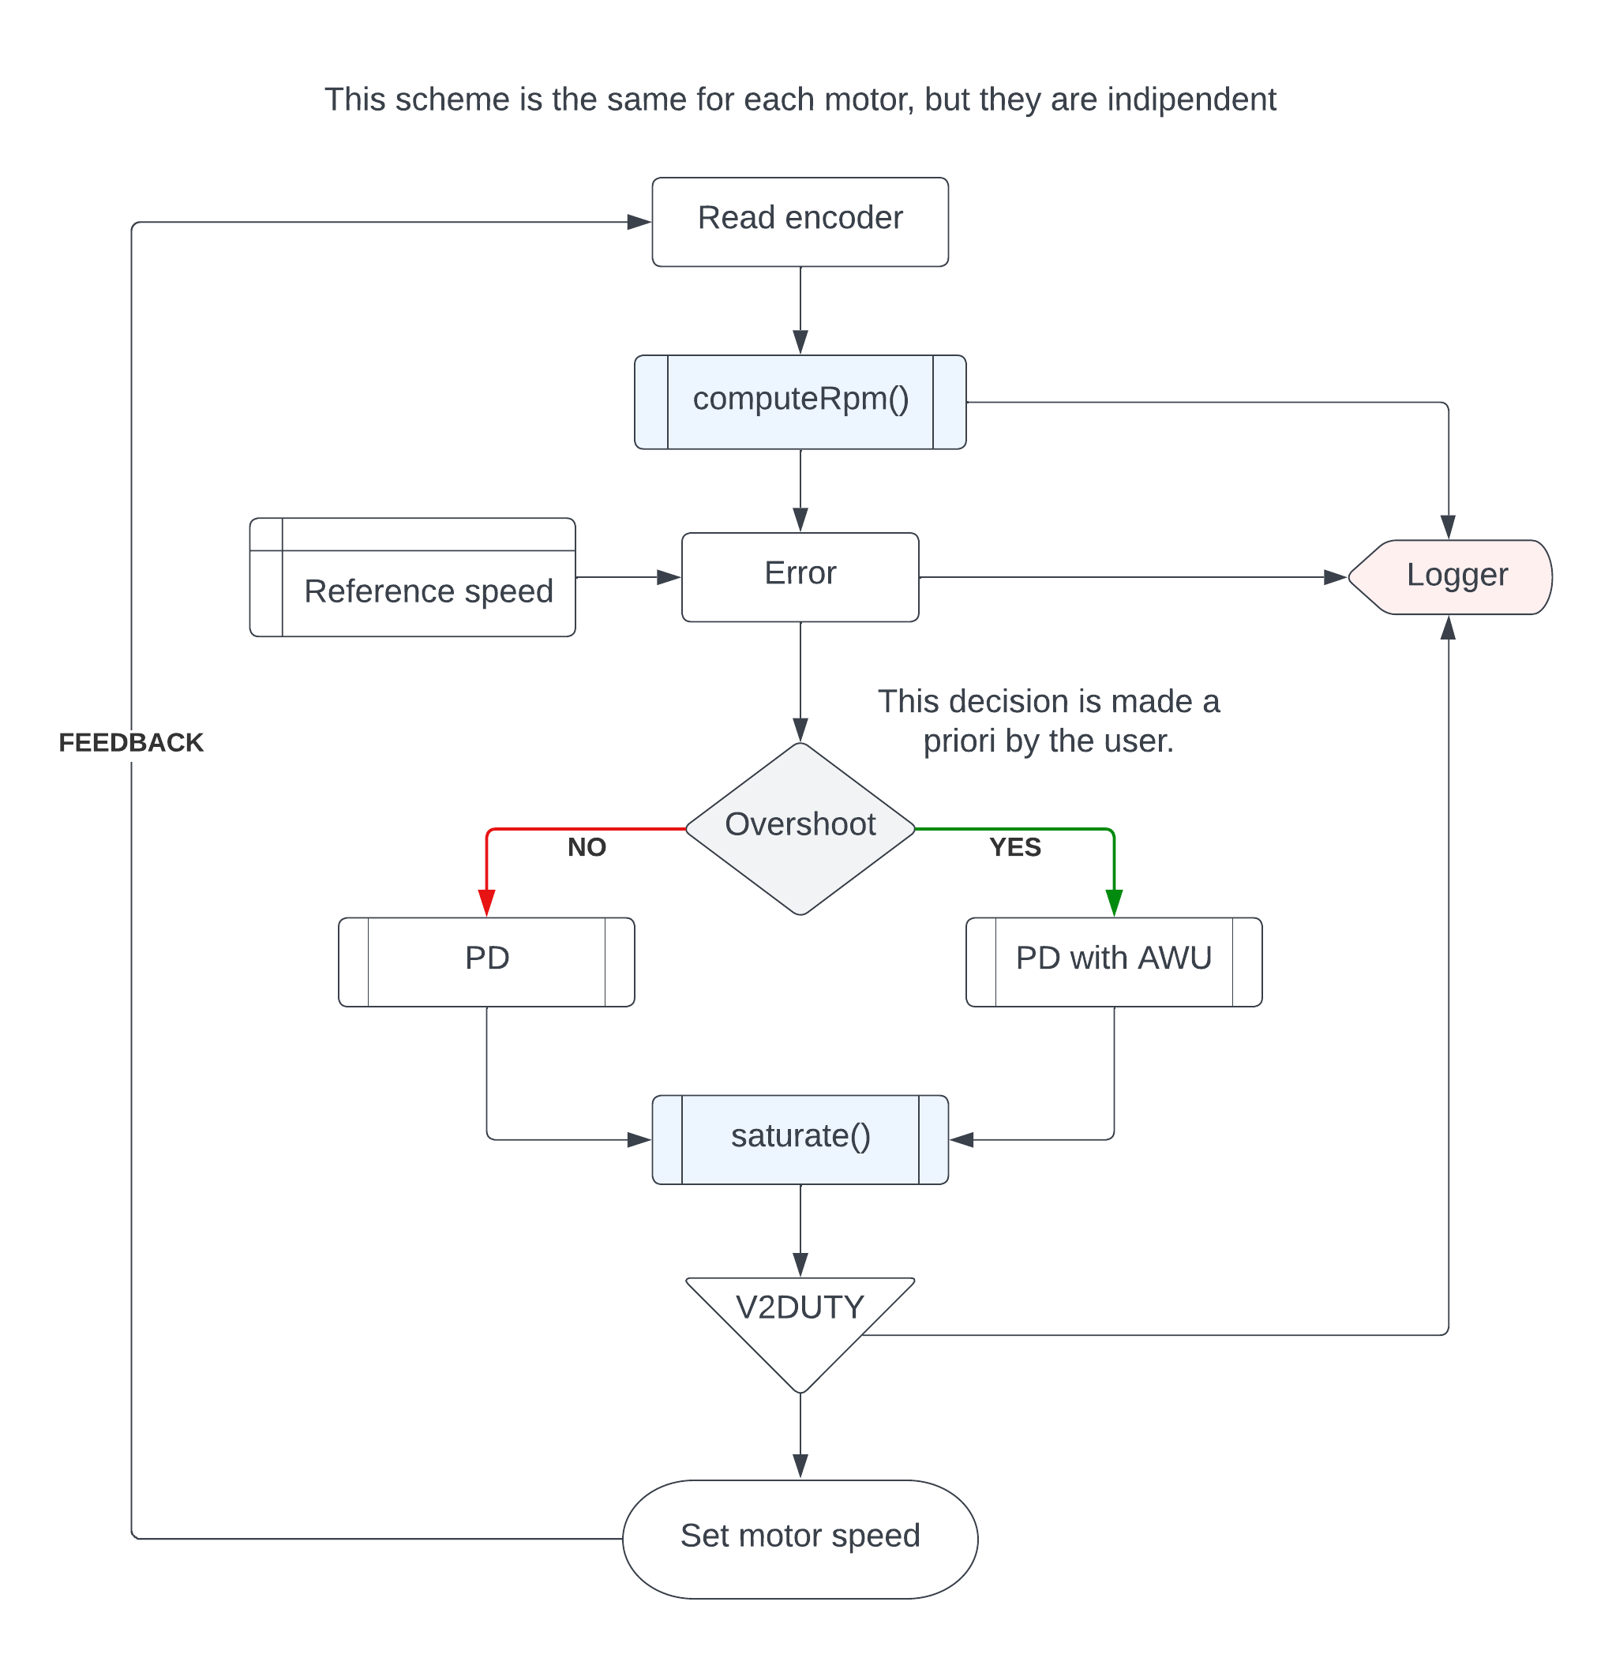
Flowchart

Slide 10
Conclusions

Slide 11
Laboratory 4 – Line tracker

Slide 12
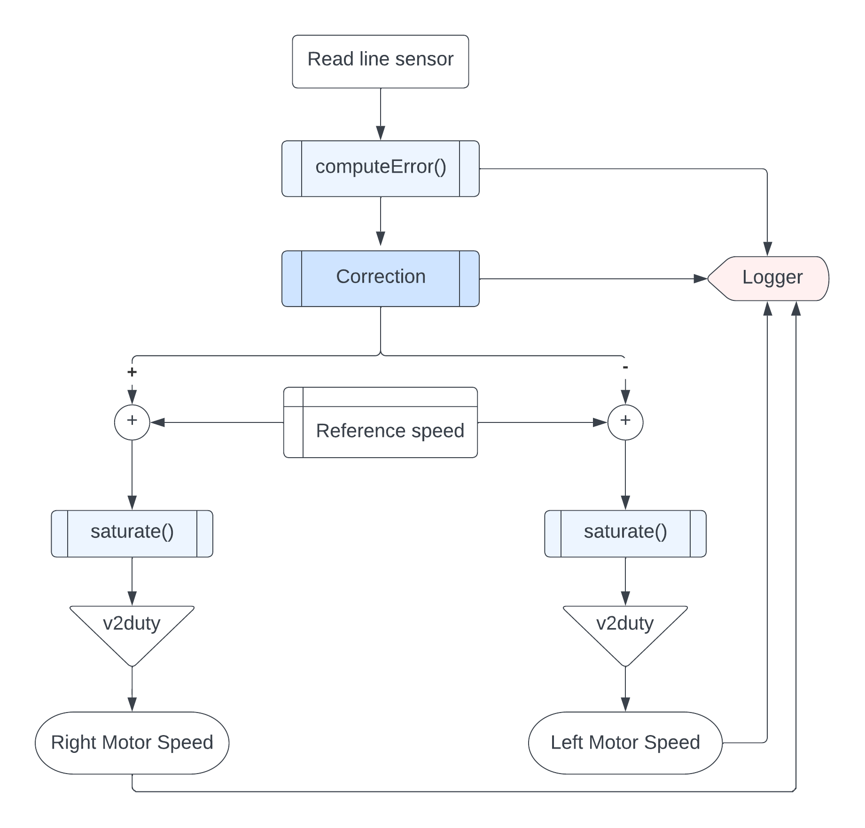
Flowchart

Slide 13
Conclusions

